Slide 1


End-to-end Layer & DNS
SE124 (2021 Fall)
IPADS, Shanghai Jiao Tong University
https://www.sjtu.edu.cn
xx

Slide 2
Review: Assurance of End-to-end Protocol
Assurance of at-least-once delivery
Assurance of at-most-once delivery
Assurance of data integrity
Assurance of stream order & closing of connections
Assurance of jitter control
Assurance of authenticity and privacy
Assurance of end-to-end performance

Slide 3
1. Assurance of At-least-once Delivery
RTT (Round-trip time)
to_time + process_time + back_time (ack)
At least once on best effort network
Send packet with nonce
Sender keeps a copy of the packet
Resend if timeout before receiving acknowledge
Receiver acknowledges a packet with its nonce
Try limit times before returning error to app

Slide 4
Review: Calculating RTT and Timeout (in TCP)
Exponentially Weighted Moving Average
Estimate both the average rtt_avg and the deviation rtt_dev
Procedure calc_rtt(rtt_sample)
rtt_avg = a*rtt_sample + (1-a)*rtt_avg; /* a = 1/8 */
dev = absolute(rtt_sample – rtt_avg);
rtt_dev = b*dev + (1-b)*rtt_dev; /* b = 1/4 */
Procedure calc_timeout(rtt_avg, rtt_dev)
Timeout = rtt_avg + 4*rtt_dev

Slide 5
How to Decide Timeout?
Fixed timer: dilemma of fixed timer
Too short: unnecessary resend
Too long: take long time to discover lost packets
Adaptive timer
E.g., adjust by currently observed RTT, set timer to 150%
Exponential back-off: doubling from a small timer
NAK (Negative AcKnowledgment)
Receiver sends a message that lists missing items
Receiver can count arriving segments rather than timer
Sender can have no timer (only once per stream)
若receiver采用的是NAK来收包，那么就说明receiver是不使用timer的，即是不回去计算是否timeout的，只会去看到底接收到了哪些包(counting)，并且会 返回丢失包的列表

Slide 6
2. Assurance of At-most-once Delivery
At-least-once delivery
Remember state at the sending side
Tends to generate duplicated requests(幂等，receiver维护请求的tid)
At-most-once delivery
Maintains a table of nonce at the receiving side
The table may grow indefinitely
Space and search time(trade-off between size and search-time)
Tombstones (something that cannot be deleted forever)
Another way: Make the application tolerate duplicated requests
Recall the NFS collapse case: server wastes time to execute duplicated requests

Slide 7
Duplicate Suppression
Monotonically increasing sequence number
Receiver discards smaller nonce, only holds the last nonce, one per sender
Now, the old nonce is a tombstone!
Use a different port for each new request
Should never reuse the old port number
But, the old port is now tombstone!

Slide 8
Duplicate Suppression
Accept the possibility of making a mistake
E.g., if sender always gives up after five RTT (cannot ensure at-least-once), then receiver can safely discard nonces that are older than five RTT(这种方式的问题:若一个packet正好对应于马上要被舍弃的那五个nonce中的第1个，(但是根据这种方式根本不应该被舍弃)，但是他却过了很长时间没有被接受，并且已经有新的包被接受了，那么这个包对应的nonce就会被舍弃使得这个慢的包在到达之后也不会被接受。)
It is possible that a packet finally shows up after long delay (solution: wait long time)
Receiver crashes and restarts: lose the table
One solution is to use a new port number each time the system restarts
Another is to ignore all packets until the number of RTT has passed since restarting, if sender tries limit times
Anyway, duplicate suppression makes the system complex

Slide 9
3. Assurance of Data Integrity
1.link layer层面的checksum不多余，因为可能发生一些硬件层面的错误，如课件提到的memory copying，网卡问题等。
2.e2e层的checksum不是一定生效的，因为对于一些只进行计算的请求，他们的checksum可能是一样的，另外，也可能出现发错IP的情况，即一个错误的checksum发送到错误的IP addr也可能被接受。
Data integrity(数据完整性)
Receiver gets the same contents as sender
Reliable delivery protocol
Sender: adds checksum to the end-to-end layer
Receiver: recalculates the checksum, discards if not match
Q: Is it redundant since link layer provides checksum?
No. Besides network, there could be other errors, e.g., in memory copying
The assurance is not absolute
What if a packet is mis-delivered and the receiver ACK?
hack：发送请求的时候，目标的IP一定要正确并且存在，但是sender的IP可以是错误的。

Slide 10
4. Segments and Reassembly of Long Messages
Bridge the difference between message and MTU
Message length: determined by application
MTU(max transfer utility): determined by network
Segment contains ID for where it fits
E.g., "message 914, segment 3 of 7"
Can be used for at-least-once and at-most-once delivery
Reassembly
Out-of-order, mingled with other message's segments
Allocating a buffer large enough to hold the message
由于将每个packet进行碎片化处理，锁需要等到每一个segment都被接受到的时候才能认为接收成功，所以需要一个较大的buffer来维护已经收到的segment的信息。

Slide 11
When Out of Order…
Solution-1: Receiver only ACK in order packets, discards others(会丢弃明明已经收到的包)
Waste of bandwidth(e.g.:接受到了1,2,3,4,这时候接收到6会被舍弃。)
Solution-2: ACK every packet and hold early packets in buffer, release the buffer when all in order
Need using large buffer when waiting for a bad packet
Solution-3: Combine the two above
Discard if buffer is full
New problem: how much buffer?
Speedup for common case
NAK to avoid timeout
If NAKs are causing duplicates, stop NAKs
TCP is based on ACK, not NAK

Slide 12
Closing of Connections
Open a stream
Create a record to keep track of which elements have been sent, received, acknowledged
Close a stream
When finish, it needs to report an end-of-stream
Both ends need to agree last element is OK and then close
1. Alice sends close request to Bob with stream record ID
2. Bob checks and agrees, sends a close ACK
3. Alice receives ACK, turn off sender, discard record
4. Alice sends "all done" to Bob
5. Bob receives "all done" and discard stream record
<- What if duplicate?

Slide 13
5. Assurance of Jitter Control
Real-time
When reliability is less important than timely delivery
A few error in a movie may not be noticed
Jitter: variability in delivery time
Strategy
Basic: delay all arriving segments

Slide 14
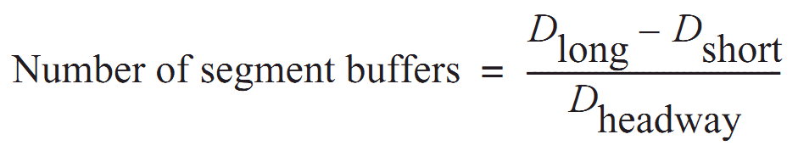
5. Assurance of Jitter Control
Measure the distribution of delays in a chart showing delay time vs. frequency of that delay
Choose an acceptable frequency of delivery failure
Determine D_{long} that longer than 99% delay
Determine the shortest delay, D_{short}
Calculate number of segment buffer:
D_{headway} is average delay between arriving segments
segement个数=
最晚到达的包的时间与最早到达的包的时间间隔除以平均的传输时间(即取计算在这个最长时间内会有多少包被传输并被接受)

Slide 15
6. Assurance of Authenticity and Privacy
Internet is dangerous
Hostile intercepts and maliciously modifies packets
Violate a protocol with malicious intent
Key-based mathematical transformations to data
Sign and verify: establish the authenticity of the source and integrity of contents
Encrypt and decrypt: maintain privacy of contents
Consideration
False sense of security, worse than no assurance
加密只会使得内容不可见，但是并不能保证内容没有被改变，即attacker可以通过用修改过的加密内容修改原始加密内容来攻击，需要通过公钥和私钥来解决。

Slide 16
6. Security: Asymmetric Encryption(非对称加密)
Public Key VS. Private Key
Public key: encrypt to identify reader (only me can read this)
Private key: encrypt to identify writer (yes, it's me who wrote this)
Poor performance, so just used to exchange symmetric key
Questions
What is a certificate? Why using a CA (Certificate Authority)?
How to exchange a symmetric key in HTTPS or SSH?
What is the root of trust?
Will be addressed later, in Security part

Slide 17
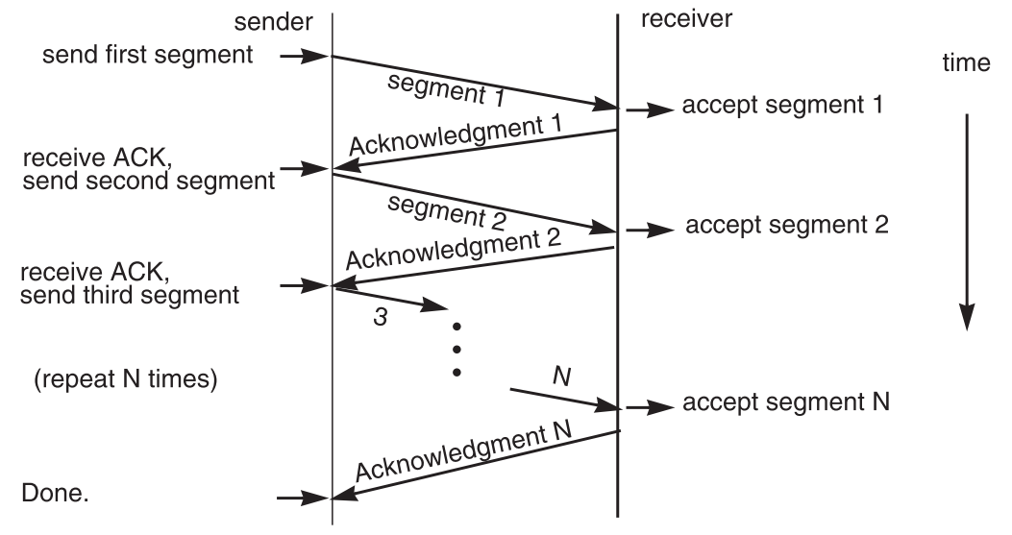
7. End-to-end Performance
Multi-segment message questions
Trade-off between complexity and performance
Lock-step protocol

Slide 18
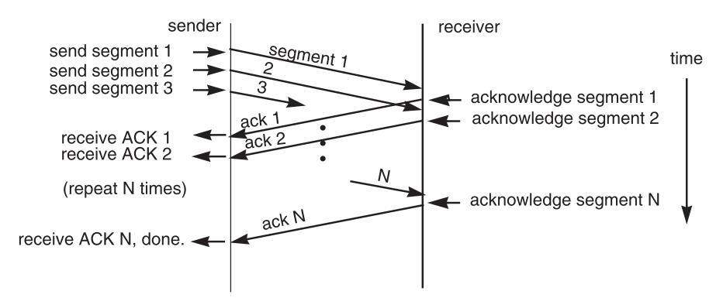
Overlapping Transmissions
Pipelining technique

Slide 19
Overlapping Transmissions
Packets or ACK may be lost
Sender holds a list of segments sent, check it off when receives ACK
Set a timer (according to RTT) for last segment
If list of missing ACK is empty, OK
If timer expires, resend packets and another timer

Slide 20
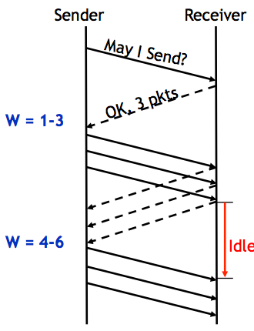
Fixed Window(固定窗口)
Receiver tells the sender a window size
Sender sends window
Receiver acks each packet as before
Window advances when all packets in previous window are acked
E.g., packets 4-6 sent, after 1-3 ack'd
If a packet times out -> resend packets
Still much idle time
由于窗口是固定的，即一个窗口中的segment是确定的，所以此时的空白间隔时间(即receiver无事情可以做)为下一个窗口的第一个包到达的时间减去当前窗口中最后一个包的ACK被发送出去的时间。

Slide 21
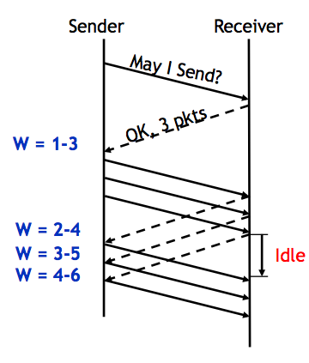
Sliding Window(滑动窗口,船口长度固定,但是内容动态变化)
Sender advances the window by 1 for each in-sequence ACK it receives
Reduces idle periods
Pipelining idea
But what's the correct value for the window?
We'll revisit this question
First, we need to understand windows
这张图片前提显然是网络是稳定的，但是实际上，可可能存在包4已经被接受，但是包3的ACK还未被接收的情况。

Slide 22
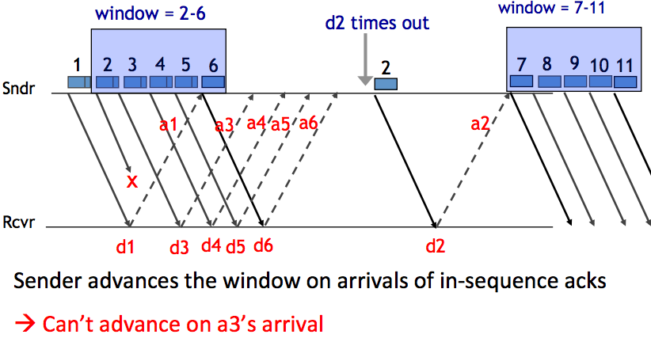
Handling Packet Loss
流程:d1对应的a1倍sender接受之后，window后移，范围变成2-6，之后2发生了丢包，3-6正常，这时候即使sender接受到了a3，但是由于没有顺序的接收到a2，所以不能继续移动窗口，所以等在那里。等到sender已经接受到a6了还是没有接受到a2，认为发生了timeout，进行包2的resend。由于a6已经被接受，所以直接就变成了7-11

Slide 23
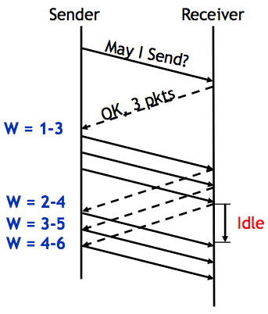
Chose the Right Window Size
If window is too small
Long idle time
(考虑极端情况即可,若长度为1,只能顺序发送)
Underutilized network
If window too large
Congestion(堵塞，冲突)
若window过大，那么可能出现的情况是
sender在一段时间内可以连续发送大量的包，
从而使得网络拥堵

Slide 24
Sliding Window Size
下面公式乘积结果就是第一个byte对应的ACK被接受的时候sender正好发出的byte的编号。
window size ≥ round-trip time × bottleneck data rate
Sliding window with one segment in size
Data rate is window size / RTT
Enlarge window size to bottleneck data rate
Data rate is window size / RTT
Enlarge window size further
Data rate is still bottleneck
Larger window makes no sense
bottleNeck即是sender与receiver传输速率中的较小者,RTT指的是一个包被传输,处理到接收到ACK的时间度量,因而两者相乘实际上就是在计算在一个RTT内会被传输的最大数据量,因而如果window-size正好等于这个值,那么就会正好在任意时刻会”填满”传输网络而不会发生阻塞。
- Receive 500 KBps
- Sender 1 MBps
- RTT 70ms
- A segment carries 0.5 KB
- Sliding window size = 35KB (70 packets)

Slide 25
Self-pacing: Sliding Window Size
Although the sender doesn't know the bottleneck, it is sending at exactly that rate
Once sender fills a sliding window, cannot send next data until receive ACK of the oldest data in the window
The receiver cannot generate ACK faster than the network can deliver data elements
RTT estimation still needed

Slide 26
TCP and Congestion Control

Slide 27
Congestion
Definition: Too many packets present in (a part of) the network causes packet delay and loss that degrades performance
Network & End-to-end layers share the responsibility for handling congestion
1. Network layer
Directly experiences the congestion
Ultimately determine what to do with the excess packets
2. End-to-end layer
Control to reduce the sending rate,(比如调整slide-window-size) is the most effective way
network架构中网络包的接收顺序是从下到上的，因而network layer会先于end to end layer检测到congestion。

Slide 28
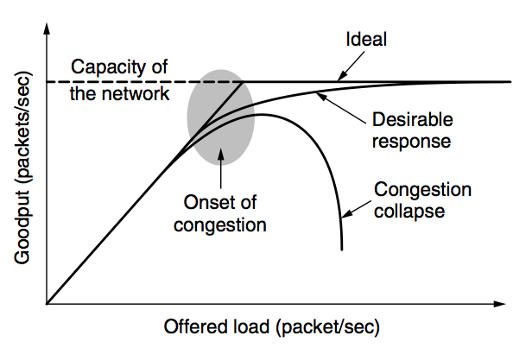
Network Congestion

Slide 29
Why Congest?
memory不够-->增加memory,但是这样做往往会加剧congestion,因为更多的memory就可以支持更长的queue,后到来的packet需要的等待时间就会更长,而TCP是基于ACK的，因而sender就更容易检测到超时从而进行重新发送，这就会导致同一个包会多次pending在同一个queue中，这只会使得congestion更加严重。
If all of a sudden, streams of packets begin arriving on three or four input lines and all need the same output line, a queue will build up
If there is insufficient memory to hold all of them, packets will be lost
Adding more memory may help up to a point, but
Nagle (1987) realized that if routers have an infinite amount of memory, congestion gets worse, not better
This is because by the time packets get to the front of the queue, they have already timed out (repeatedly) and duplicates have been sent

Slide 30
Load Shedding: Setting Window Size
For performance:
window size ≥ round-trip time × bottleneck data rate
For congestion control:
window size ≤ min(RTT x bottleneck data rate, Receiver buffer)
Congestion window
2 windows become 1
to achieve best performance and avoid congestion

Slide 31
Congestion Control
Basic idea:
Increase congestion window slowly
If no drops -> no congestion yet
If a drop occurs -> decrease congestion window quickly
Use the idea in a distributed protocol that achieves:
Efficiency: i.e., uses the bottleneck capacity efficiently
Fairness, i.e., senders sharing a bottleneck get equal throughput (if they have demands)

Slide 32
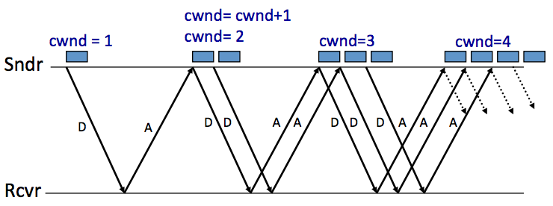
AIMD (Additive Increase, Multiplicative Decrease)
Every RTT:
No drop: cwnd = cwnd + 1(线性增加)
A drop: cwnd = cwnd / 2(指数下降)

Slide 33
Problems with AIMD
Increases very slowly at the beginning
Initial window size is 1
Probably too small in practice
Solution: do multiplicative increase at the beginning
Congestion_window _{init} = 1
Initially, do Congestion_window ← 2 * Congestion_window each RTT until we hit congestion
Named "slow start" (even though it's exponentially fast!)

Slide 34
TCP Slow Start
At the beginning of the connection, exponential increase the window
Double it every RTT until you see loss
Decreases the time it takes for the initial window to "ramp up"
So the name is really weird... it should be "fast start"

Slide 35
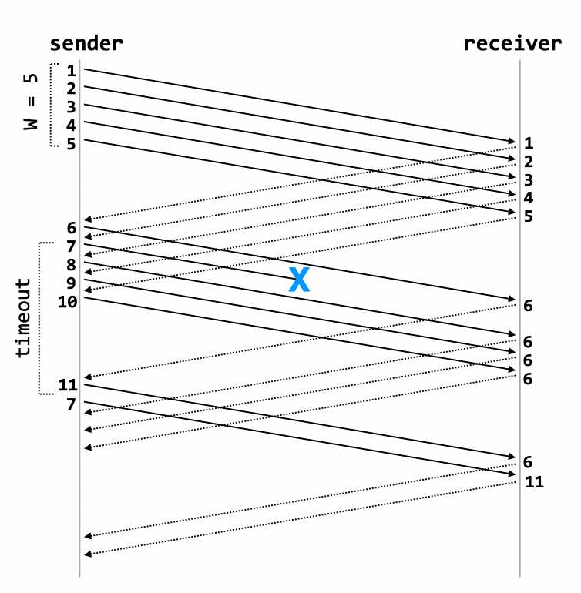
TCP Fast Retransmit / Fast Recovery
When a sender receives an ACK with sequence number X, and then three(5-1(自己的那个)-1(丢包的那个)) duplicates of that packet, it immediately retransmits packet X+1
Example: sender receives 5 6 6 6 6
Infers that packet 7 is lost, immediately retransmits
On fast-retransmit, window decrease is as before: W = W/2

Slide 36
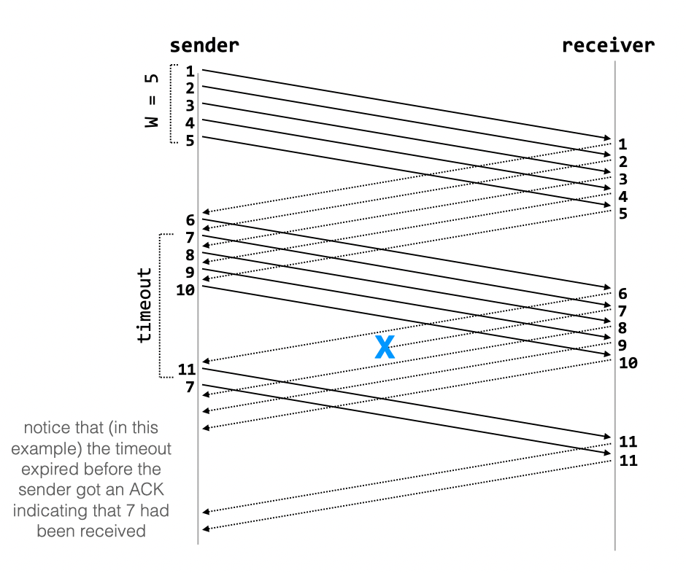
TCP Fast Retransmit / Fast Recovery
When a packet is lost due to timeout, (这时候会直接变成1重新开始)TCP behaves differently:
W = 1, then do slow-start until the last good window
Reasoning: if there is a retransmission due to timeout, then there is significant loss in the network, and senders should back way off

Slide 37
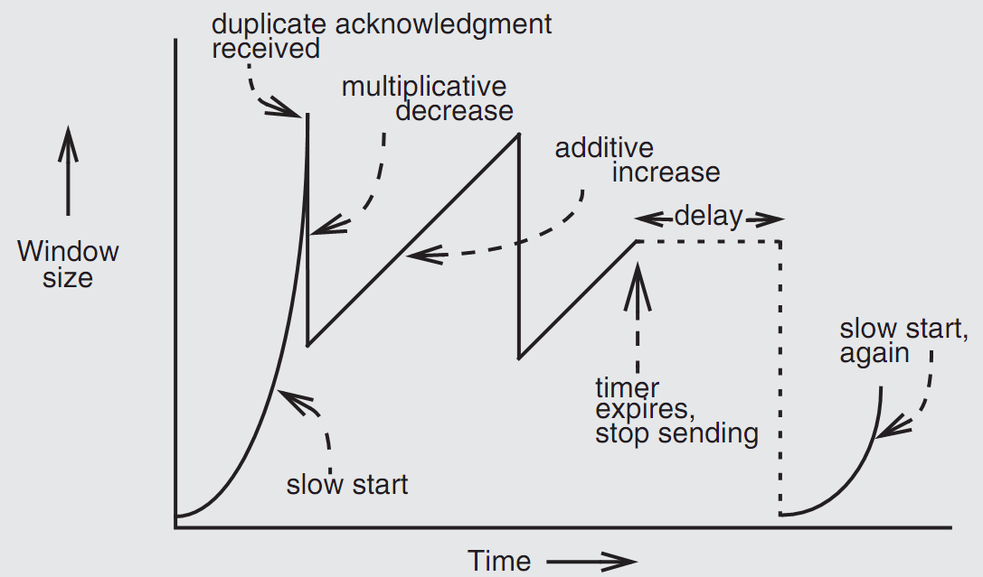
Retrofitting TCP

Slide 38
Retrofitting TCP
1. Slow start: one packet at first, then double until
Sender reaches the window size suggested by the receiver
All the available data has been dispatched
Sender detects that a packet it sent has been discarded
2. Duplicate ACK
When receiver gets an out-of-order packet, it sends back a duplicate of latest ACK
3. Equilibrium
Additive increase & multiplicative decrease
4. Restart, after waiting a short time

Slide 39
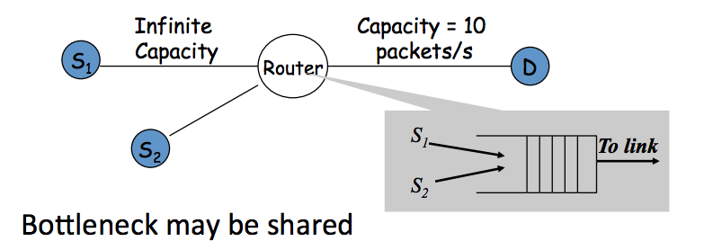
Fairness between Links

Slide 40
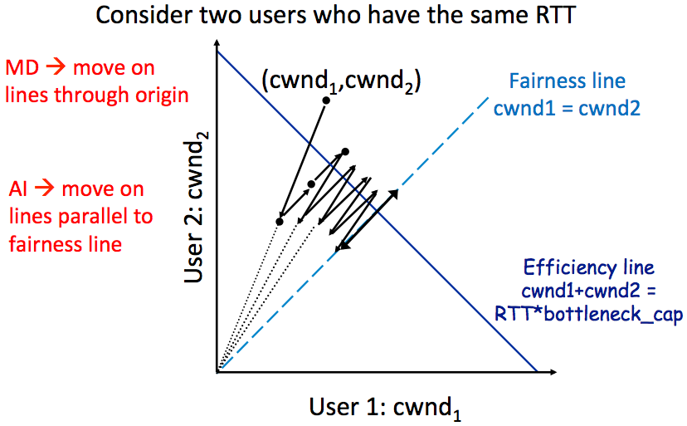
AIMD Leads to Efficiency and Fairness
AI：只改变截距而不改变斜率，
所以是沿着x+y=C的垂直方向移动，所以是沿着平行于fairness线移动；
MD:每次截距变为原来的一半，所以与x,y同时除以2之后的点在同一条与原点之间的连线上面

Slide 41
Q: Why not Additive Decrease
It does not converge to fairness
from a congested point, (x',y'), reducing each by 1 worsens fairness and takes us away from the "ideal" outcome(只做加减法的话(x,y)一直会在某一条与x+y=C垂直的线上面移动，并且假设y>x的话，那么随着减小与原点的连线斜率会越来越大，也就是”take us away”,同时，之后还会进行additive increase，还会沿着原来的路径走回去，随意如果初始状态是unfair的，那么终止状态还是unfair的。同时做相同的加减法不会改变大小关系)

Slide 42
Weakness of TCP
If routers have too much buffering, causes long delays
Packet loss is not always caused by congestion(还可能是网络本身问题)
Consider wireless network: if losing packet, sender may send faster instead
TCP does not perform well in datacenters
High bandwidth, low delay situations
TCP has a bias against long RTTs
Throughput inversely proportionally to RTT
Consider when sending packets really far away vs really close
Assumes cooperating sources, which is not always a good assumption

Slide 43
Summary of Congestion Window
Reliability Using Sliding Window
Tx Rate = W / RTT
Congestion Control
W = min(Receiver_buffer, cwnd)
Congestion window is adapted by the congestion control protocol to ensure efficiency and fairness
TCP congestion control uses AIMD which provides fairness and efficiency in a distributed way

Slide 44
The Design of DNS
Domain Name Service

Slide 45
DNS: Binding IP and Domain Name
Names: hostname strings
E.g., www.sjtu.edu.cn
Values: IP addresses
E.g., 202.120.2.119
Look-up algorithm
Resolves a hostname to an IP address so that your machine knows where to send packets

Slide 46
IP Address as a Type of Name
An IP address itself is a type of name
A structured name that is used to locate an object
Use IP address to identify the server
Recall your labs in ICS on socket
On Internet
The router will know where to send a packet with destination IP
Hostname has no such semantic
A router does not know how to send a packet to "baidu.com"

Slide 47
Why Not Just Using IP Address?
IPs are structured in a particular way for routing
You cannot chose your IP address as you wish
Note: usually an address cannot be picked
While you can chose your host names
IPs are not user-friendly enough

Slide 48
Questions on DNS
Q: Can a name have multiple values (IP addresses)?
Yes
This allows a web server to balance its load over multiple machines
Also allows a client to choice a nearest IP to access
Q: Can a single value have multiple names?
Yes
This allows server consolidation

Slide 49
Questions on DNS
Q: Can the value corresponding to a name change?
Yes
This allows to change the physical machine (with different IP) that stores the data without changing the hostname
Such changing is hidden to clients

Slide 50
Look-up Algorithm
At first, each machine kept a "hosts.txt" for address binding
E.g., "r900 202.120.224.83"
Using table look-up to resolve the binding
This method cannot scale in Internet
1984, four Berkeley students wrote BIND
Berkeley Internet Name Domain
Still the dominant DNS software in use

Slide 51
Distributing Responsibility
The binding
Too large to be stored on a single machine
Thus, the data are stored on many machines
As known as "name servers"
How to know which name server has a particular binding?
Solution: structure the hostname
Names have a hierarchy, e.g., com, net, gov, correspond to "zones"
Zones are mapped to name servers

Slide 52

Name Servers
The root zone
Maintained by ICANN, non-profit
The ".com" zone
Maintained by VeriSign, add for money
The ".sjtu.edu.cn" zone
Maintained by SJTU

Slide 53
DNS Hierarchy (a partial view)

Slide 54
Basic DNS Look-up Algorithm
Example: lookup IP of "ipads.se.sjtu.edu.cn"
Traverse the name hierarchy from the root
The root will tell us the "cn" name server IP,
which will tell us the "edu.cn" name server IP,
which will tell us the "sjtu.edu.cn" name server IP,
which will tell us the "se.sjtu.edu.cn" name server IP,
which finally tells us the "ipads.se.sjtu.edu.cn" IP
Such algorithm is called delegation

Slide 55
DNS Lookup

Slide 56
DNS Lookup

Slide 57
DNS Lookup

Slide 58
DNS Lookup

Slide 59
DNS Lookup

Slide 60
Context in DNS
Names in DNS are global (context-free)
A hostname means the same thing everywhere in DNS
Actually, it should be "ipads.se.sjtu.edu.cn."
A hostname is a list of domain names concatenated with dots
The root domain is unnamed, i.e., "." + blank

Slide 61
Fault Tolerant
Each zone can have multiple name servers
A delegation usually contains a list of name servers
If one name server is down, others can be used

Slide 62
Three Enhancements on Look-up Algorithm
1. The initial DNS request can go to any name server, not just the root server
Even on your own machine: /etc/hosts
You can specific name servers in /etc/resolv.conf
If no record, just return address of the root server
Q: what are the benefits?
Notes:
To minimize the load of the root server.

Slide 63
Three Enhancements on Look-up Algorithm
2. Recursion
A client asks a name server "www.baidu.com"
The name server does all the lookup through the tree and return the IP of Baidu to the client
Usually, a name server has a better network connection

Slide 64
DNS Request Process
a.root.net
a.root.net
names.edu
names.edu
NS: for edu
ns.iss.edu
ns.iss.edu
NS: for
Scholarly.edu
ginger.
Scholar.edu
ginger.
Scholar.edu
ginger.
Scholar.edu
AP: for
ginger.Scholar.edu
Name client
Name client
Non-Recursion
Recursion

Slide 65
Three Enhancements on Look-up Algorithm
3. Caching
DNS clients and name servers keep a cache of names
Your browser will not do two look-ups for one address
Cache has expire time limit
Controlled by a time-to-live parameter in the response itself
E.g., SJTU sets the TTL of www.sjtu.edu.cn to 24h
TTL (Time To Live)
Long TTL VS. short TTL
Q: what are the tradeoffs?

Slide 66
Combine These Enhancements
If:
Many machines at SJTU use the SJTU name server for their initial DNS query
The name server offers recursive querying and caching
Then:
The name server's cache will hold many bindings
Performance benefits from this large cache

Slide 67
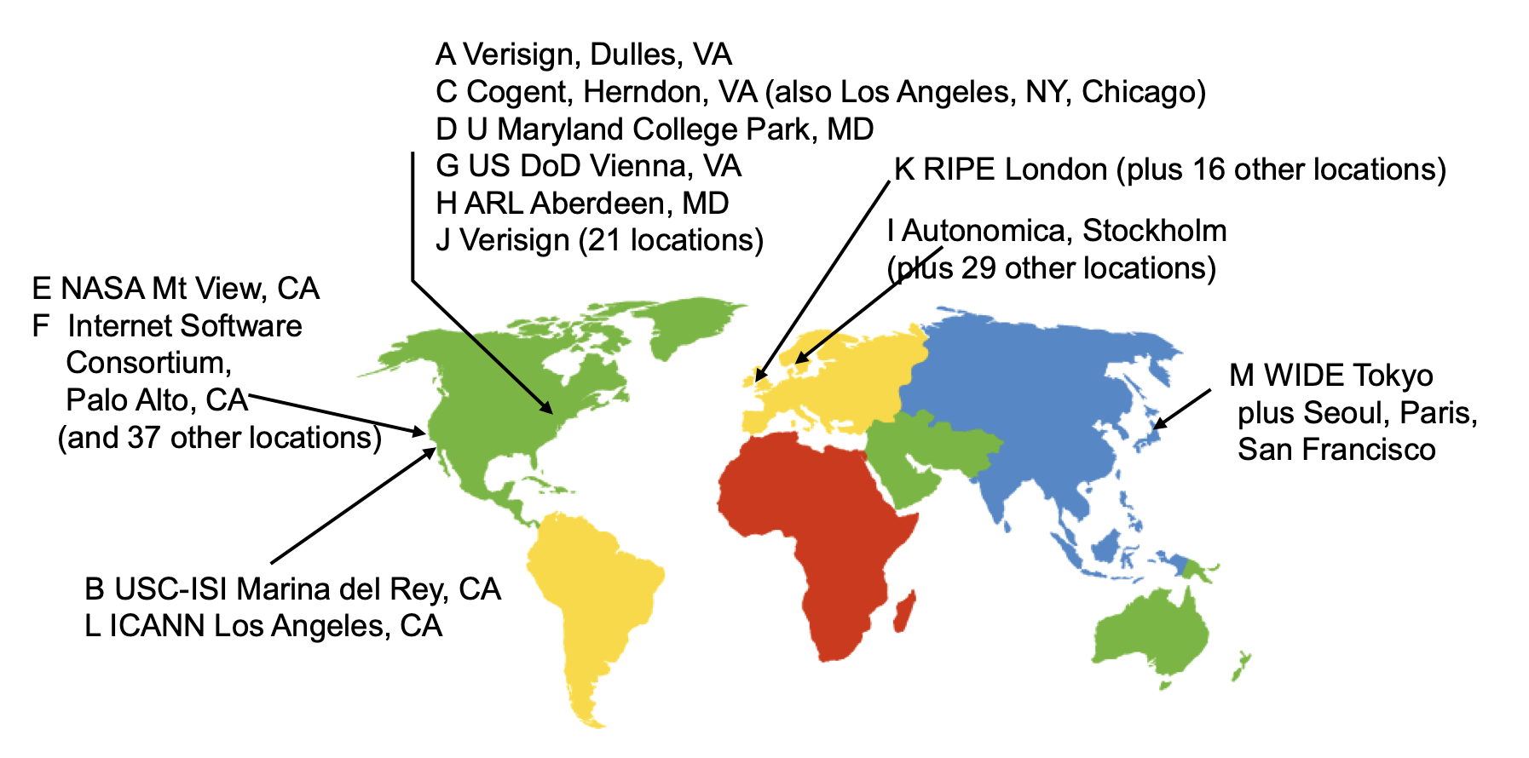
Other Features of DNS
At least two identical replica servers
80 replicas of the root name server in 2008
Replicas are placed separated around the world

Slide 68
Other Features of DNS
Organization's name server (e.g., SJTU)
Several replicas in campus
To enable communications within the organization
At least one out of the campus
To validate the address for outside world

Slide 69
Name Discovery in DNS (at the first place)
A client must discover the name of a nearby name server
Name discovery broadcast to ISP at first time
Ask network manager
Ask by email, Google, etc.

Slide 70
Comparing Hostname & Filename
They are both for more user friendly
File-name -> inode number
Host-name -> IP address
The file-name and host-name are hierarchical; inode num and IP address are plane
They are both not a part of the object
File-name is not a part of a file (stored in directory)
Host-name is not a part of a website (stored on name server)
Name and value binding
File: 1-name -> N-values (no); N-name -> 1-value (yes)
DNS: 1-name -> N-values (yes); N-name -> 1-value (yes)

Slide 71
Behind the DNS Design
Why was DNS designed in this way?

Slide 72
Benefits of Hierarchical Design
Hierarchies delegate responsibility
Each zone is only responsible for a small portion
Hierarchies also limit interaction between modules
A type of de-centralization

Slide 73
Good Points on DNS Design
Global names (assuming same root servers)
No need to specific a context
DNS has no trouble generating unique names
The name can also be user-friendly
Scalable in performance
Simplicity: look-up is simple and can be done by a PC
Caching: reduce number of total queries
Delegation: many name severs handle lookups

Slide 74
Good Points on DNS Design
Scalable in management
Each zone makes its own policy decision on binding
Hierarchy is great here
Fault tolerant
If one name server breaks, other will still work
Duplicated name server for a same zone

Slide 75
Bad Points on DNS Design
Policy
Who should control the root zone, .com zone, etc.? Governments?
Significant load on root servers
Many DNS clients starts by talking to root server
Many queries for non-existent names, becomes a DoS attack
Security
How does a client know if the response is correct?
How does VeriSign know "change Amazon.com IP" is legal?

Slide 76
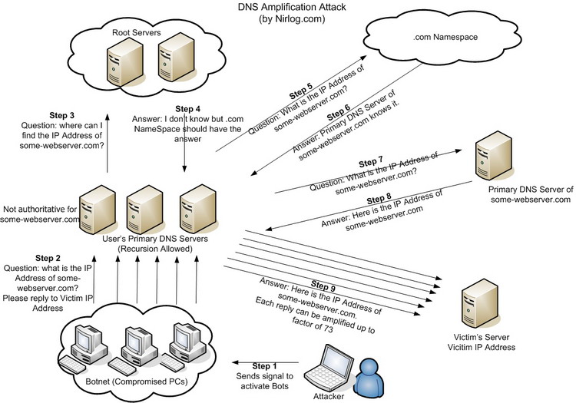
DNS Amplification Attack

Slide 77
DNS Security
DNS Hijack: Cutting the binding between name and IP
DNS DoS (Denial of Service) attack
BAOFENG.com & DNSPod
2009-5-18: DNSPod was attacked and banned
2009-5-19: The Internet in China was almost down
Fixed timer: query for BAOFENG.com once per second!
Solutions
/etc/hosts, dnsmasq, OpenDNS, etc.
DNS shield to defend against DoS attack

Slide 78

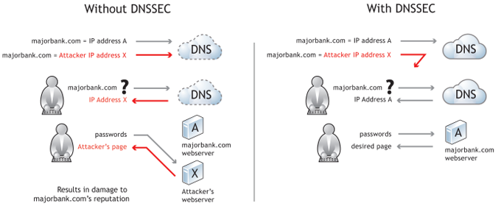
DNSSEC: Protect DNS Record
Only part of the zones are using DNSSEC, e.g., .gov, .org

Slide 79
Naming Scheme
Naming: the glue of modules

Slide 80
Naming in General
ipads.se.sjtu.edu.cn – hostname
steven@apple.com - email
steven – username
EAX - x86 processor register name
main() - function name
WebBrowser - class name
/courses/cse/index.html - path name (fully-qualified)
index.html - path name (relative)
http://ipads.se.sjtu.edu.cn/courses/cse/index.html - URL
13918275839- Phone number
202.120.40.188 - IP Address

Slide 81
Naming a Disk
File name: /dev/sda1
As a special type of inode: device inode
8,0 as (major, minor)
PCI address (name): 19:00.0
SCSI storage controller: LSI Logic / Symbios Logic SAS1068E PCI-Express Fusion-MPT SAS (rev 08)

Slide 82
Naming for Modularity
Retrieval: e.g., using URL to get a web page
Sharing: e.g., passing an object reference to a function
Save space as well: only sending the name, not the object
Hiding: e.g., using a file name without knowing file system
Can support access control: use an object only if knowing its name
E.g., Windows has many undocumented API
User-friendly identifiers: e.g., “homework.txt” instead of 0x051DE540
Indirection: e.g., OS can move the location of the file data without notifying the user
Have you ever defragmented your hard driver?

Slide 83
Addresses as Names
Software uses these names in an obvious way
E.g., memory addresses
Hardware modules connected to a bus
Use bus addresses (a kind of name) for interconnection

Slide 84
Naming Schemes
A naming schemes contains three parts:
1. Set of all possible names
You cannot use ‘for’ as a variable in C
2. Set of all possible values
3. Look-up algorithm to translate a name into a value
or a set of values, or “none”

Slide 85
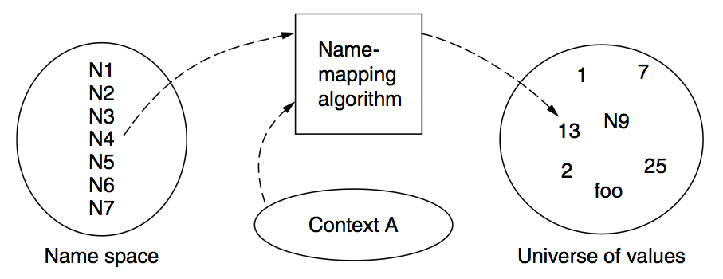
Naming Model

Slide 86
Naming Terminology
Binding – A mapping from a name to value
Unbind is to delete the mapping
A name that has a mapping is bound
A name mapping algorithm resolves a name

Slide 87
Naming Context
Type-1: context and name are separated
E.g., inode number’s context is the file system
Type-2: context is part of the name
E.g., xiayubin@sjtu.edu.cn
Name spaces with only one possible context are called universal name spaces
Example: credit card number, UUID, email address

Slide 88
Determining Context - 1
Hard code it in the resolver
Examples: Many universal name spaces work this way
Embedded in name itself
cse@sjtu.edu.cn:
Name = “cse”
Context = “sjtu.edu.cn”
/ipads.se.sjtu.edu.cn/courses/cse/README :
Name = “README”
Context = “/ipads.se.sjtu.edu.cn/courses/cse”

Slide 89
Determining Context - 2
Taken from environment (Dynamic)
Unix cmd: “rm foo”:
Name = “foo”, context is current dir
Question: how to find the binary of “rm” command?
Read memory 0x7c911109:
Name = “0x7c911109”,
Context is thread’s address space
Many errors in systems due to using wrong context

Slide 90
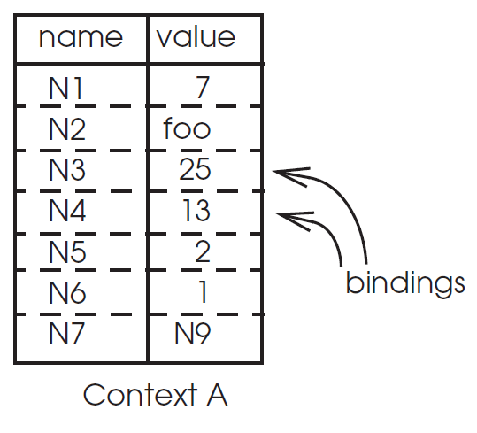
Name Mapping Algorithms - 1
Table lookup
Find name in a table
E.g., Phone book
Context: which table?
Implicit VS. explicit
Default context

Slide 91
Name Mapping Algorithms - 2
Recursive lookup
E.g., “/usr/bin/rm”
First find “usr” in “/”, then find “bin” in “/usr”, then “rm”
Each look-up process is the same
Multiple lookup
Recall: how to find “rm” without absolute name?
$PATH
E.g., “/usr/local/sbin:/usr/local/bin:/usr/sbin:/usr/bin:/sbin:/bin”
Look-up in a predefined list of context

Slide 92
Interpreter Naming API
value ← RESOLVE(name, context)
Return the mapping of name in the context
status ← BIND(name, value, context)
Establish a name to value mapping in the context
status ← UNBIND(name, context)
Delete name from context
list ← ENUMERATE(context)
Return a list of all bindings
result ← COMPARE(name1, name2)
Check if name1 and name2 are equal

Slide 93
FAQ of Naming Scheme - 1
What is the syntax of names?
What are the possible value?
What context is used to resolve names?
Who specifies the context?
Is a particular name global (context-free) or local?

Slide 94
FAQ of Naming Scheme - 2
Does every name have a value?
Or, can you have “dangling” names?
Can a single name have multiple values?
Does every value have a name?
Or, can you name everything?
Can a single value have multiple names?
Or, are there synonyms?
Can the value corresponding to a name change over time?

